Slide 1
Closed Loop Reporting for BMUG
Zak Pines | www.MoneyballMarketer.com | @MoneyballMktr

Slide 2
Why Closed Loop Marketing?
Connect marketing metrics and follow-on sales efforts, to be predictive of future performance and business growth
Measure the impact and influence of marketing investments
Notes:
Tighten the connection between marketing metrics and follow-on sales metrics (Opportunities, Pipeline, Wins, Velocity) such that marketing metrics can become predictive of future sales performance in driving predictable business growth

Slide 3
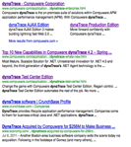
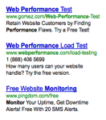
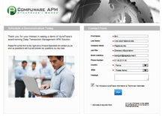
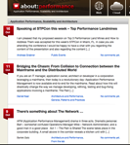
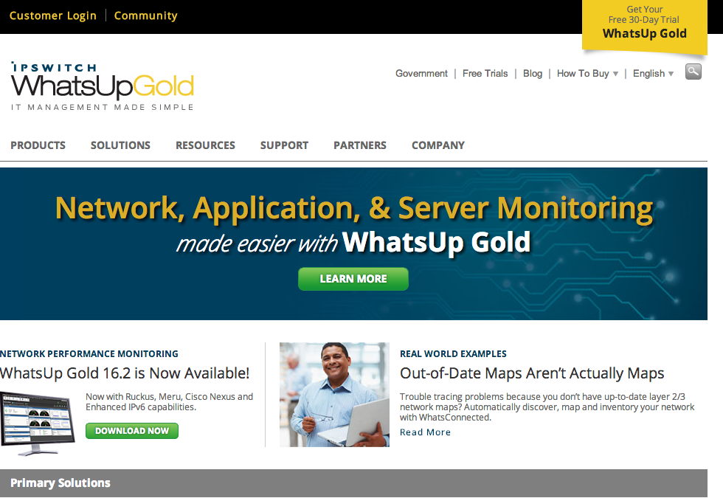
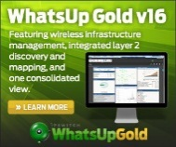
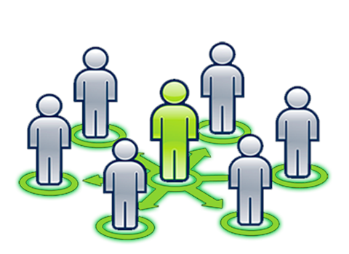
High Velocity Digital Marketing
Offers/CTAs
Free Trials
Whitepapers
Events
Freemium
Webinars
eBooks
Organic
Leads
How are we growing MQIs?
And through which channels & offers?
Landing Page
Landing Page
Net new campaigns
(suspects)
SEM
What are our top performing MQL sources?
Blog
What is our cost/MQL by channel?
Nurture campaigns
(Prospects, customers)
What is our cost/MQI by channel?
Website
Retarget
How are we converting MQIs to MQLs?
What content is generating MQIs?
Social
How long & how many touches?
Inbound
Outbound
Affiliate

Slide 4
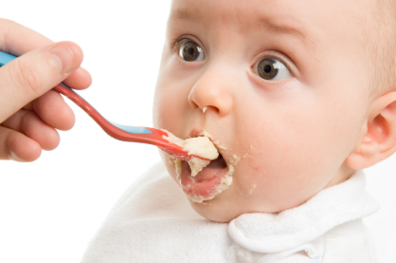
Key Principle
Marketo Feeds SalesForce
Reporting out of SalesForce data – “one source of truth”

Slide 5
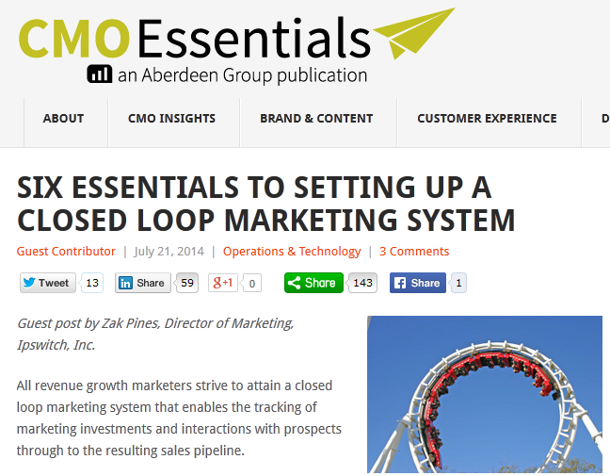
Six Steps to Closed Loop Marketing
Setup Lead Revenue Stages (MQI, MQL, SAL, SQL)
Stamp Progression Date/Time
Track Lead Source/Medium/Details for both MQI & MQL
Sync All MQIs to CRM
Setup Programs/Campaigns for All Activities (Website, Paid Search, Content, Programs incl Nurturing)
Tag Acquisition & MQL/Conversion Programs to lead records

Slide 6
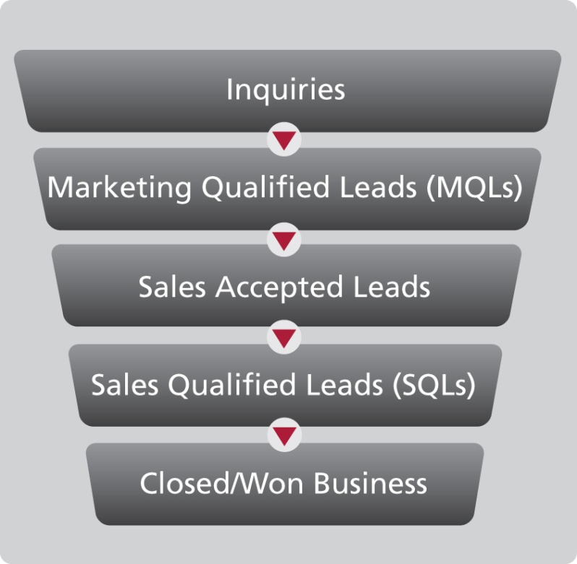
Key “Health Check” Metrics
SiriusDecisions Waterfall
Key Health Metrics
Unique Visitors | Page Views | Bounce Rate
(MQIs)
Total MQIs | Net New MQIs | Active Marketing Database
What % of MQLs ‘graduate’ from MQIs?
Net New MQLs | Customer MQLs | Upsell MQLs
Net New Opps| Customer Opps | Upsell Opps
MQL-to-Opp Conv Rate for each

Slide 7
Measurement of Programs: Slice & Dice
Theme
E.g. Compliance for the Borderless Enterprise
Program
Intersection of Content & Specific Vehicle
For outbound – cost investment & point in time (e.g. Webinar Aug 2014)
Medium
Website, Blog, Social Media, Paid Search, Email, Retargeting, Syndication
Media Outlet (Specific Vehicle)
Google Branded Search, Non Branded Search, Retargeting, Display Network
LinkedIn Ads, Sponsored Posts
Specific Publishers e.g. Madison Logic, Network World, IDG
Call to Action
Free Trial, Free Tool, White Paper, eGuide, Webinar, On Demand Webinar, Analyst Report, Case Study
Content Asset
Specific Asset

Slide 8
Measurement of Program Success: A-I-C
Acquisition
Net New MQIs acquired by the program… & their follow-on performance (MQL, Opportunity, Pipeline $, Bookings, etc.)
Measures “first touch”
A given lead can only have one acquisition program
Influence
All Leads who engage to the program & their follow-on performance
Ideal for program comparison, NOT used for summation (Top Performers, Low Performers)
A given lead can and should have multiple influence programs
Very useful for identify low performers
In future: develop a weighting system
Conversion
Measures program on “last touch” prior to MQL conversion, and follow on metrics
A given lead can only have one conversion program
A
I
C

Slide 9
Program Performance – Template
Name | Cost | MQIs Acquired | MQIs Influenced | MQLs Acquired (MQI to MQL conv rate) | MQLs Influenced (MQI to MQL conv rate) | MQLs Converted | SQLs/Opps | Pipeline $ | Pipeline/Cost

